Slide 1

07.29.2024
JANAVI KOLPEKWAR
AMSHULA GAJULA
CS329E: TERM PROJECT
ASSESSING
LOAN APPROVAL

Slide 2




WALKTHROUGH OF OUR STEPS
RESEARCH QUESTION
&
EXPECTATIONS
MODEL IMPLEMENTATION
&
ACTUAL RESULTS
BACKGROUND
&
Exploratory Data Analysis
EVALUATION AND FINAL ASSESSMENT OF RESULTS

Slide 3

01
BACKGROUND

Slide 4

LOAN APPROVAL DATASET
BRIEF BACKGROUND
For our Term project, we have selected a randomized
Loan Approval Dataset which contains a collection of financial records and associate information used to determine whether a unique set of individuals are eligible for obtaining loans from a lending institution. Using Machine Learning algorithms and Data Mining techniques we have learned in class this semester, we will select features which we believe significantly affects an applicant’s approval status.
12 VARIABLES WITHIN THE DATASET
Gender | Married | Dependents | Education
Self Employed | Applicant Income | Co-Applicant Income | Loan Amount
Loan Amount Term | Credit History | Property Area | Loan Status

Slide 5
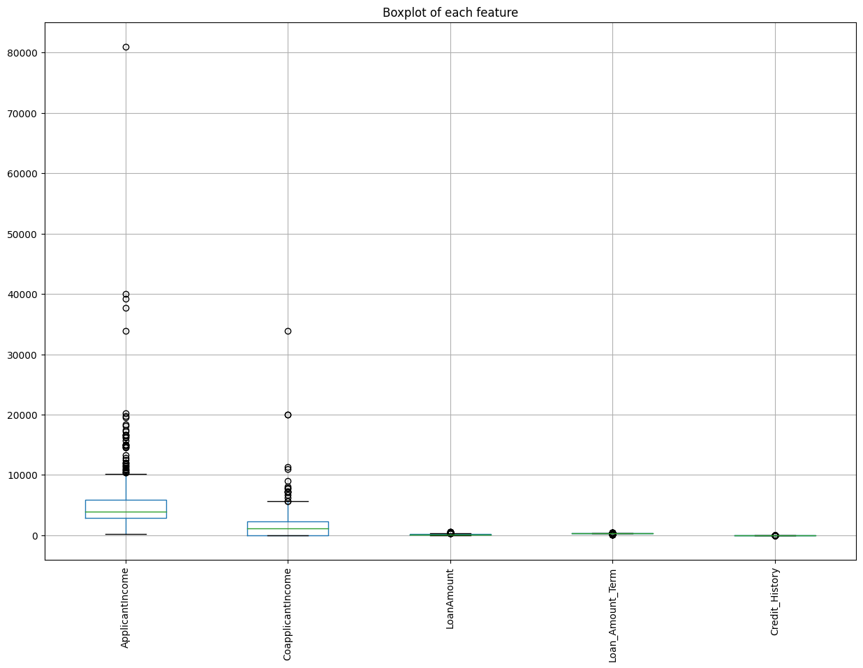
NUMERICAL FEATURES
> Applicant Income
> Co-applicant Income
> Loan Amount
> Loan Amount Term
> Credit History

Slide 6
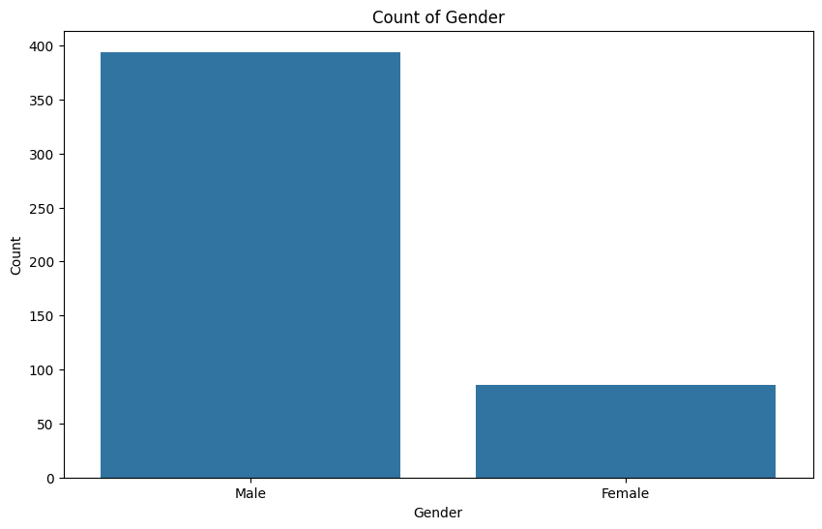
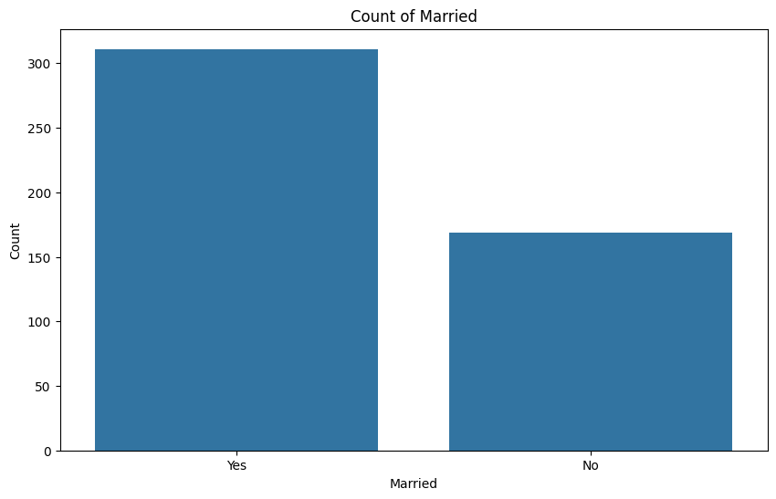
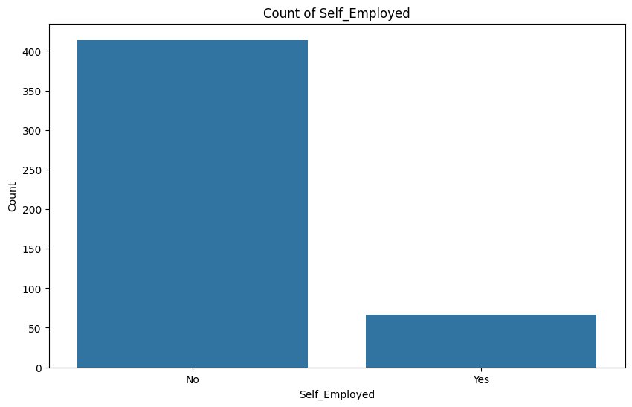
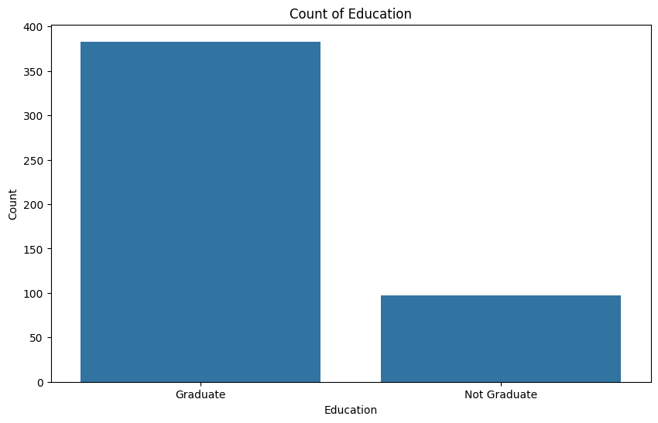
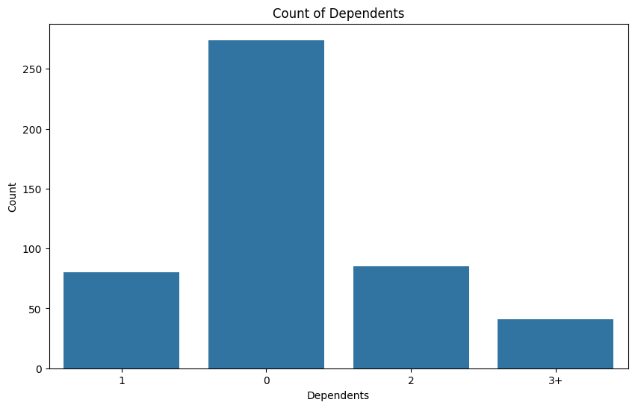
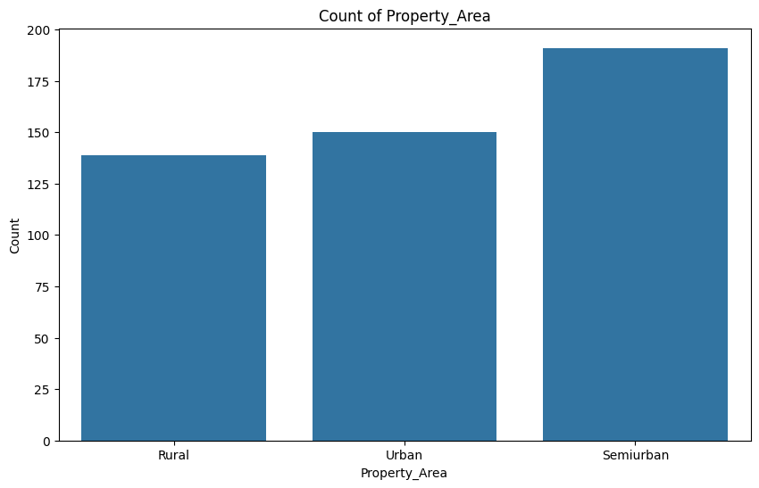
CATEGORICAL FEATURES
> Gender
> Married
> Dependents
> Education
> Self Employed
> Property Area

Slide 7
02
RESEARCH QUESTION &
EXPECTATIONS
CANVA CORPORATION

Slide 8

ML MODEL IMPLEMENTATION
The purpose of our Data Mining and Learning algorithm techniques will be to build a series of Classification models and identify which feature/s highly influence the decision to determine whether an individual is eligible for loan approval or not. We will practice Classification techniques and methods we have learned in class to implement Logistic Regression, Random Forest Classification, SVM and KNN model techniques to study our test and training sets. A thorough evaluation of the Classification Reports and correlation coefficient values will help us answer our Research Question.
RESEARCH QUESTION
What feature/s significantly influences decision-making on loan approval status?
CANVA CORPORATION

Slide 9
EXPECTATIONS
We will arrive at a conclusion to determine which feature/s highly influence the decision to determine if an individual is eligible for loan approval. We know that not all features will be equally significant in influencing the approval decision and our expectation is the visual data and numerical outcomes we seek from the series of regression and classification techniques we will implement will help us answer this. In supporting this decision, we hope to identify one Classification model that will be best fit for our data.
In the real world, this process would help us make an appropriate decision to determine whether an individual is eligible for loan approval.
CORRELATION MATRIX
BOX PLOTS
BAR PLOTS
ENCODING CATEGORICAL TO BE AS TYPE

Slide 10
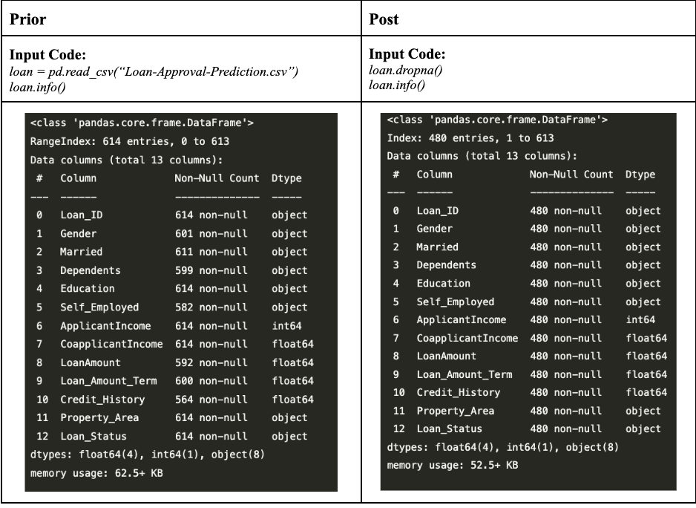
MISSINGNESS
Notes:
The dataset consists of 615 observations (rows) and 12 features (columns) some which include missing values. Once we replace the missing values, there are a total of 480 observations in the data set. When we first load out dataset and use the load.info() code function to identify the total number of entries in our dataset, we observe features like “Dependents”, “Self-Employed”, “Loan Amount”, and “Credit History” having the lowest Non-Null Counts in comparison to the other features. Once we utilize loan.dropna(), we notice that all features have the same Non-Null Count making it easier for us to later manipulate the data and fine tune ML models to our dataset. Below is an example of prior and post accounting for missing values and the impact it has on the size of our dataset.

Slide 11
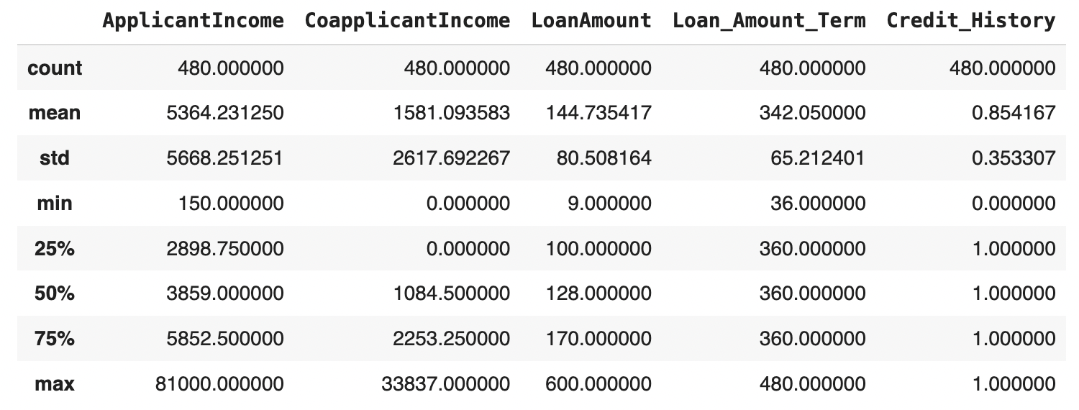
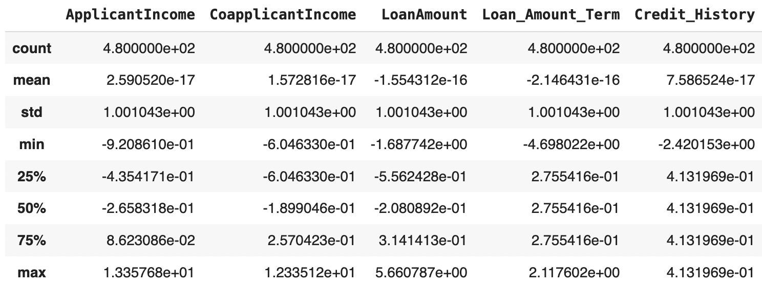
NORMALIZATION & SCALING
Before:
After:
Notes:
Normalizing or scaling data is often recommended for certain machine learning models, but not all. Here's a brief recommendation for each of the mentioned models:
Logistic Regression:
Recommendation: Yes, normalize.
Reason: Logistic regression can benefit from normalized data as it can improve the convergence rate during optimization.
Support Vector Machine (SVM):
Recommendation: Yes, normalize.
Reason: SVMs are sensitive to the scales of features because they use distances between data points to find the optimal hyperplane.
K-Nearest Neighbors (KNN):
Recommendation: Yes, normalize.
Reason: KNN is distance-based, so features on different scales can skew the distances and affect the model performance.
This process transforms the data to have a mean of 0 and a standard deviation of 1.
The scaler was fit to the data and then used to transform it. This means the scaler calculated the mean and standard deviation of each column from the training data and then applied the transformation:
Mean close to 0: This means the average value of each column is now zero.
Standard deviation close to 1: This means the spread of the values is now standardized.
By normalizing, you ensure that each feature contributes equally to the model, improving the training process and model performance.

Slide 12
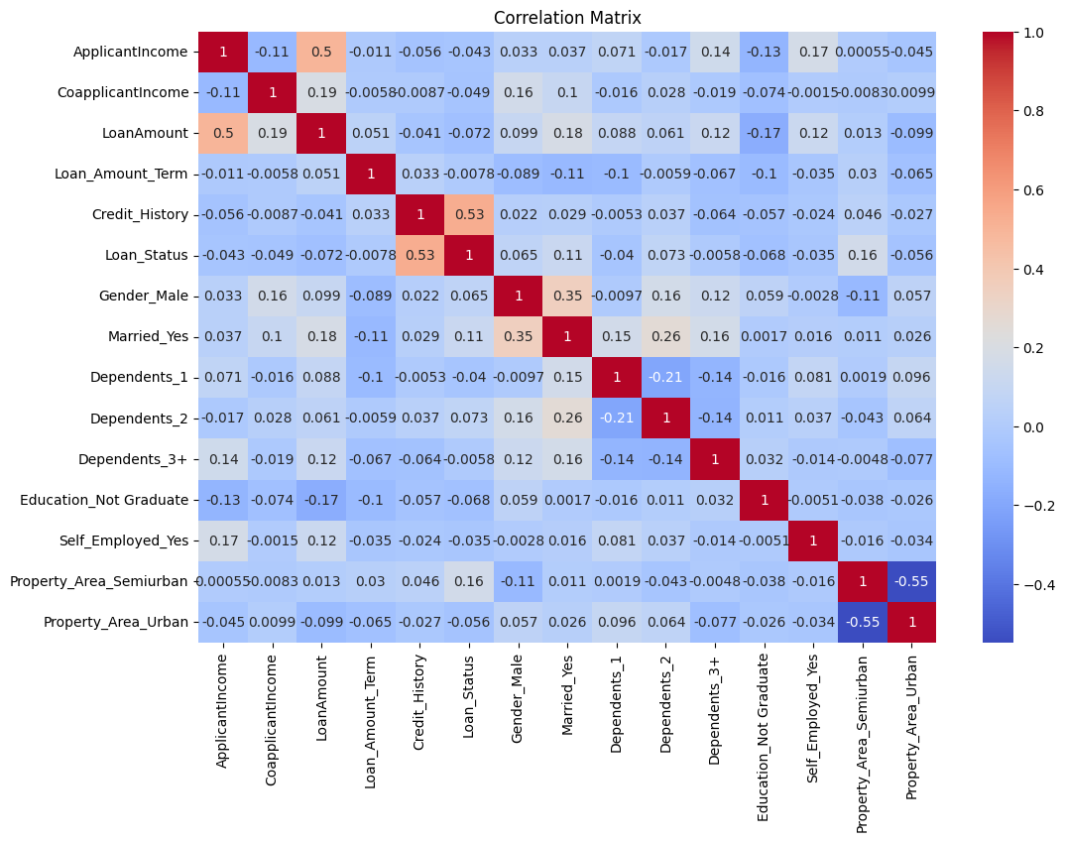
CORRELATION MATRIX & HYPOTHESIS
We hypothesize that loan approval status will be mainly influenced by credit history.

Slide 13
03
MODEL IMPLEMENTATIONS &
RESULTS
CANVA CORPORATION

Slide 14
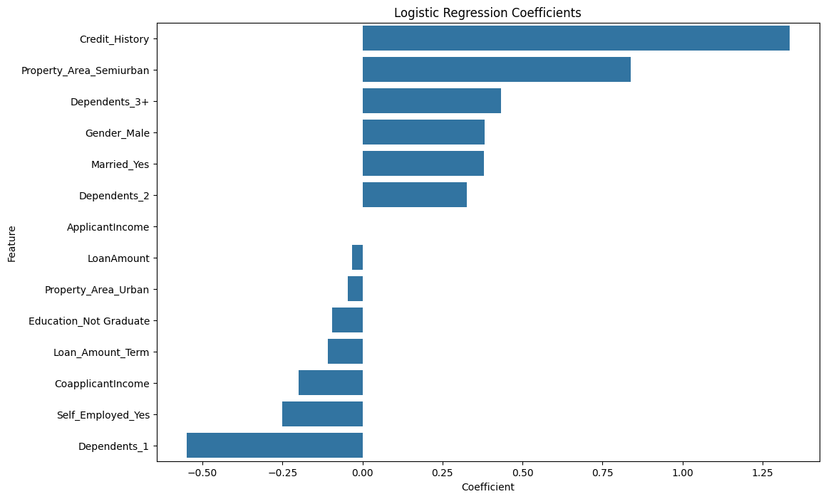
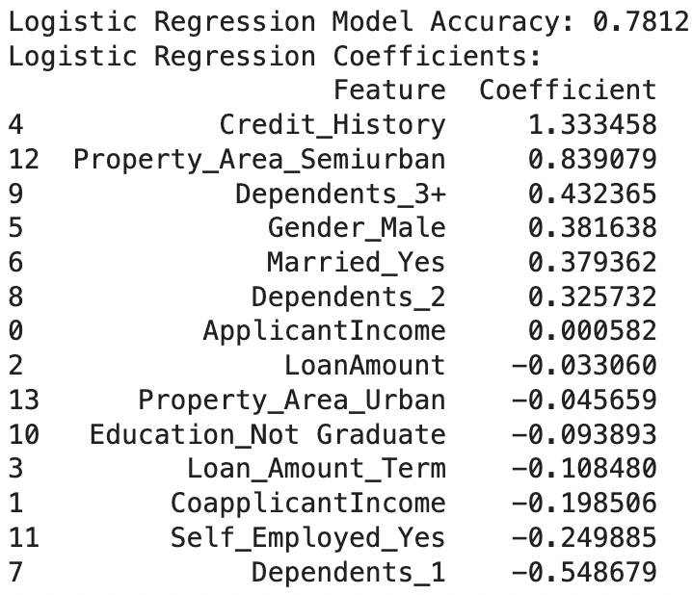
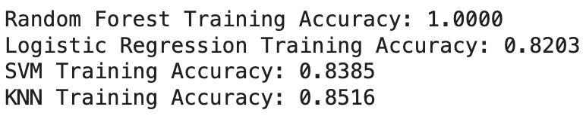
LOGISTIC REGRESSION
Why this model?
Results
> versatile and able to tackle binary classification problems
> provides a probabilistic framework for classification questions
> best probability approach in classifications to calculate preducations
Model Fit
Optimal
Notes:
training accuracy higher than model accuracy
Logistic Regression Model
Accuracy: The accuracy of the Logistic Regression model on the test data was log_reg_accuracy.
Coefficients: The coefficients for the Logistic Regression model were logistic_importance_df.
Interpretation: Coefficients show the impact of each feature on the target variable. Positive coefficients indicate features that increase the probability of loan approval, while negative coefficients indicate features that decrease it.

Slide 15
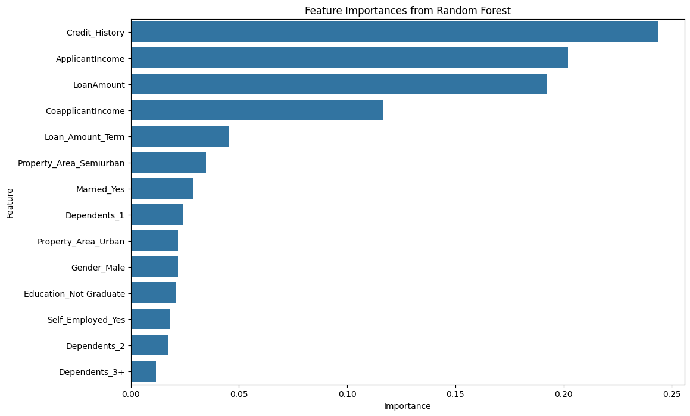
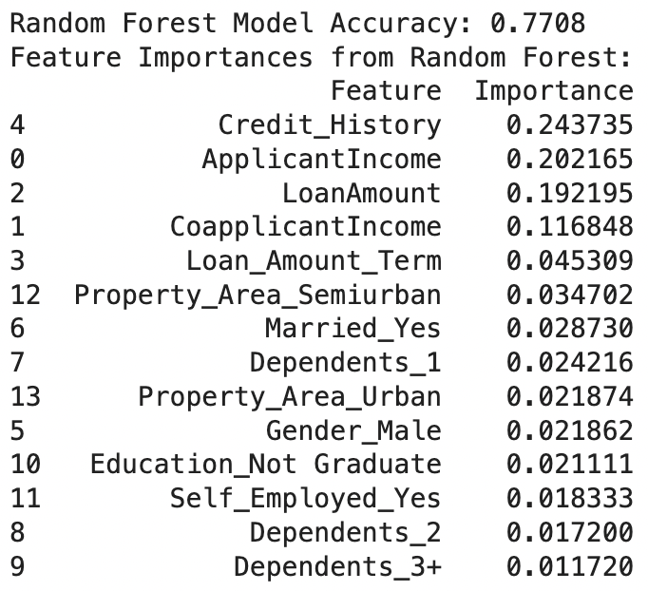
RANDOM FOREST CLASSIFICATION
Why this model?
Results
> combines multiple decision trees to improve overall accuracy
> handles highly dimensionality and considered highly robust to noisy data
Explanation of Results
Model Fit
Overfitted
DON'T FORGET TO DELETE THIS PAGE BEFORE PRESENTING.
Notes:
Random Forest Model
Accuracy: The accuracy of the Random Forest model on the test data was rf_accuracy.
Feature Importances: The most important features were feature_importance_df.
Interpretation: The Random Forest model is often robust to overfitting due to its ensemble nature. The feature importances show which features have the most predictive power.

Slide 16
SUPPORT VECTOR MACHINE (SVM)
Why this model?
Results
> not sensitive to outliers and able to tackle highly-dimensional data
> able to reduce overfitting and supports versatility in kernel functions (polynomial, RBF, sigmoid, etc.)
Explanation of Results
Model Fit
Overfitted
DON'T FORGET TO DELETE THIS PAGE BEFORE PRESENTING.
Notes:
The Support Vector Machine, aka (SVM) is a classification learning model used to detect outliers and used to separate data into different classes. For the purposes of our dataset, we decided to fit a kernel function parameter, which helps us determine the type of decision boundary. The 'sigmoid' kernel is a type of non-linear kernel that can be useful for certain types of data distributions, especially when the data is not linearly separable. So in the context in our SVM Model, a highlighting difference between the original SVM fit and the sigmoid' kernel fit is 0.01 between accuracy scores.
The 'sigmoid' kernel was chosen as the best option for your data, indicating that the relationship between out features and labels may be non-linear and similar in nature to the transformations used in neural networks. Even though slight, 0.01 increase in accuracy scores, the SVM model fit with kernel function 'sigmoid' is still an improvement.
SVM Model
Accuracy: The accuracy of the SVM model on the test data was svm_accuracy.
Interpretation: SVM is effective for high-dimensional spaces and generally performs well with clear margins of separation. However, it can be sensitive to the choice of kernel and regularization parameters.

Slide 17
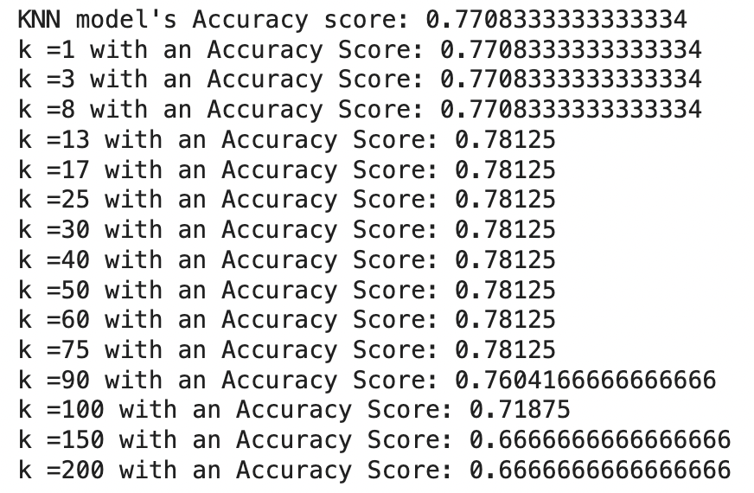
K-NEAREST NEIGHBOR (KNN)
Why this model?
Results
> effective with smaller dataset and endorses feature scaling for numerical and categorical data
> provides flexibility to tackle non-linear and complex patterns
Explanation of Results
Model Fit
Overfitted
DON'T FORGET TO DELETE THIS PAGE BEFORE PRESENTING.
Notes:
As a modification and review of analysis for our data, we decided to test multiple k-values for out KNN model fitting. In general, we know that 'k' represents the number of the nearest neighbors that are used to make predictions for a given data point. When we take for example k=1, the model looks at the closest single data point to determine the class of the new data point, leading to potentially noisy decision making. In the vice versa case, we will notice larger 'k' values will smooth out the boundary for decision -making and essentially help the model generalize better.
A method we incorporated in model is known as cross-validation in which we evaluate the model's performance based on varied k-values and determine which one yields the highest accuracy score.
Based on a thorough review of our outcome k-value examples, we will notice a steady trend in accuracy scores between k values 13 to 75. This range of 'k' values seems to provide the best balance between bias and variance, capturing enough detail without overfitting or underfitting our data!
K-Nearest Neighbors Model
Accuracy: The accuracy of the KNN model with k=3 on the test data was knn_accuracy.
Varying k: Testing different values of k showed varying accuracy scores, indicating the sensitivity of KNN to the choice of k.
Interpretation: KNN can perform well with the right choice of k, but it is computationally expensive and can be sensitive to the scaling of data.

Slide 18
04
FINAL EVALUATION
CANVA CORPORATION

Slide 19

BEST FEATURE: CREDIT HISTORY
BEST
MODEL: LOGISTIC REGRESSION

Slide 20

RELEVANCE
> Drawing a Real World Application:
After a thorough analysis of each model fit, including an interpretation for each outcome, we conclude that for an individual applying for a loan approval must prioritize their credit scores and review their credit history.

Slide 21
RESOURCES
Loan Approval Dataset
IMCU: How do Banks & Mortgage Lenders Determine Pre-Approval Amount?
Choosing the Right Classification Model

